Slide 1
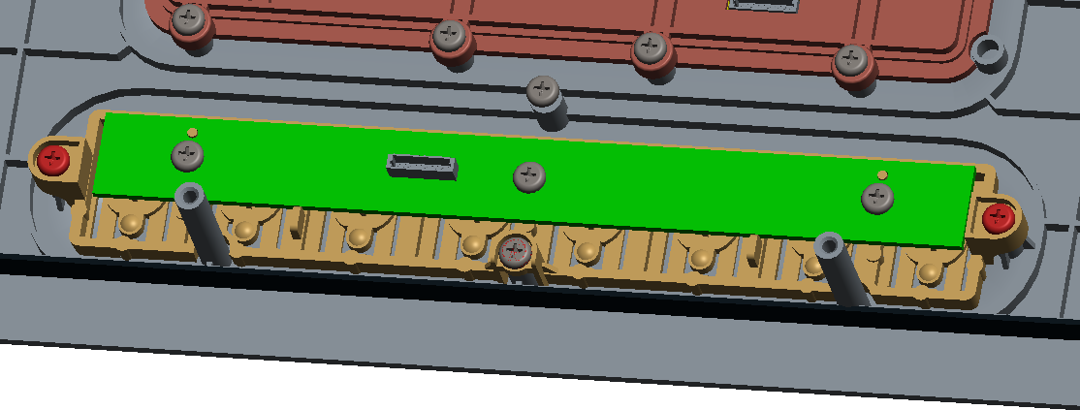
Found that on current mockup samples, the touch feeling was not the same on each button, one or two keys were worse than others.
(because mock-up samples on our hand are not many and need Inkel to look into this potential issue)
Pre-action if issues still existed after DVT :
may add more ribs from case top to support button part, to avoid case top and button part are designed as surface by surface matching.
The springs of button may be revised to be more elastic probably.
Feedback from Inkel
19.oct’20 Mecha: It was confirmed through a mockup, and the improvement plan was reflected.
Button part

Slide 2
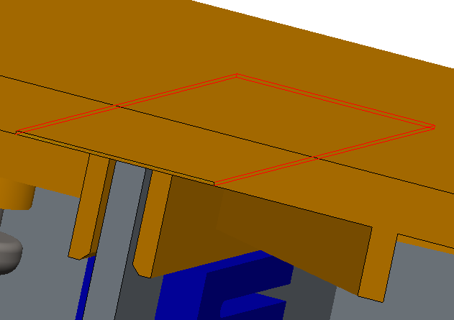
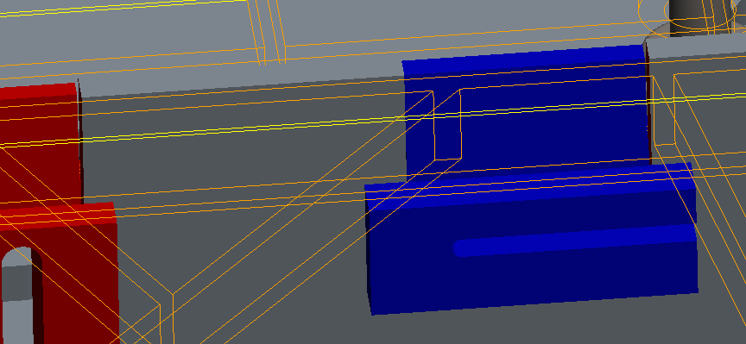
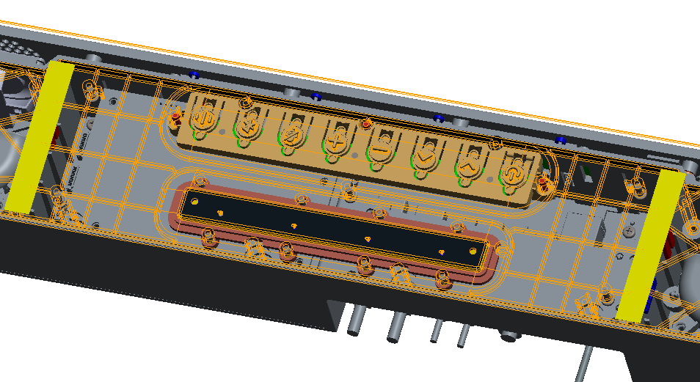
Pre-action if leakage still existed after DVT :
may thicken the foams to fill in the gap space.
Foam-1/foam-2(in yellow)
Gap between rubber and case

Slide 3
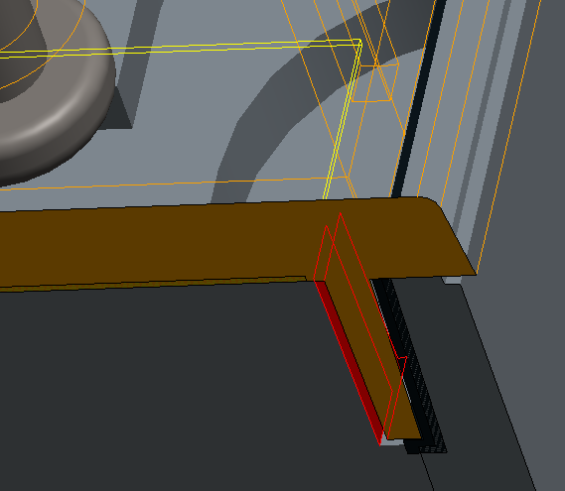
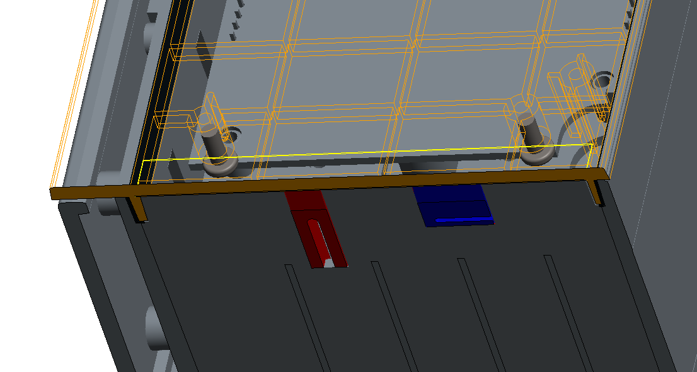
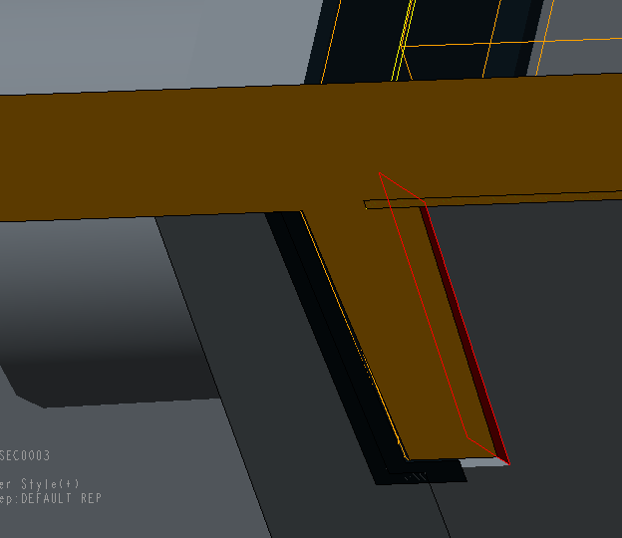
Pre-action if leakage still existed after DVT :
may extend the foams to fill in the gap space.
gaps

Slide 4
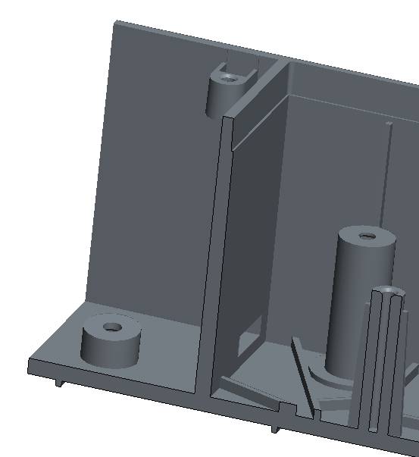
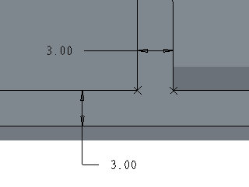
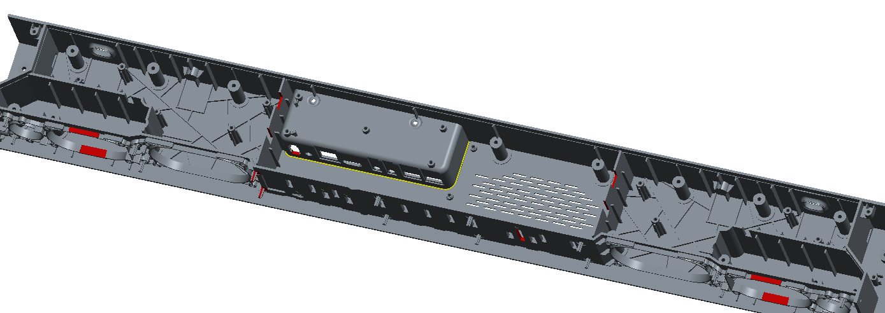
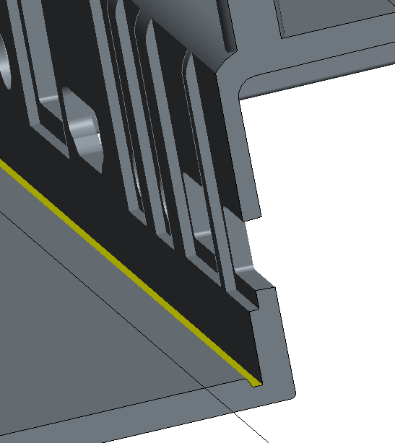
We can see the groove feature (A area) has been created to prevent molding defects on case bottom.
But silimar design features( likes B area )are still not optimized yet, has the tooling shop evaluated and confirmed that it is workable for molding as well?
B
B
A
Groove to prevent molding issues
B
A
B
Feedback from Inkel
19.oct’20 Mecha : The condition of part A is a condition to reduce adverse effects on the lower side of the product.
However, the condition of Part B is not so.

Slide 5
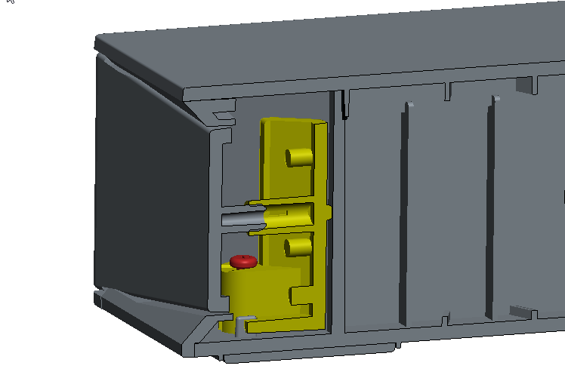
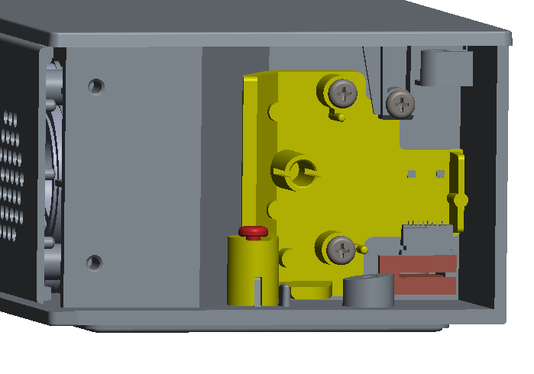
Pls evaluate if it is available to add ribs from case top, to limite the potential movement or shake on bracket-side-LED, there seems only one screw to fix this part.
ALT
Side LED Bracket fix point : screw 1 pcs + Grill conjunction
Feedback from Inkel
19.oct’20 Mecha : "Case Top" is an important part where the condition of the upper side affects the appearance quality.
The more shapes are added to the lower side of the "Case Top", the worse the condition of the upper side.

Slide 6
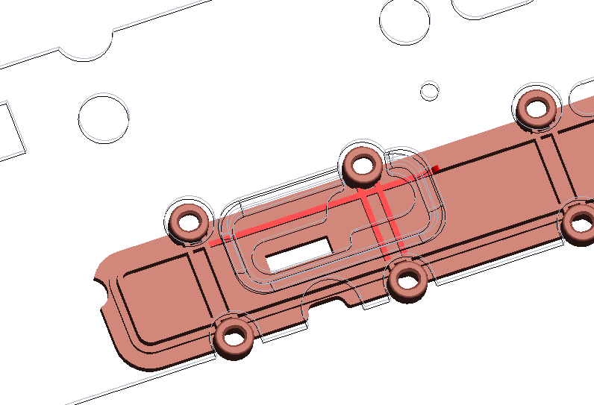
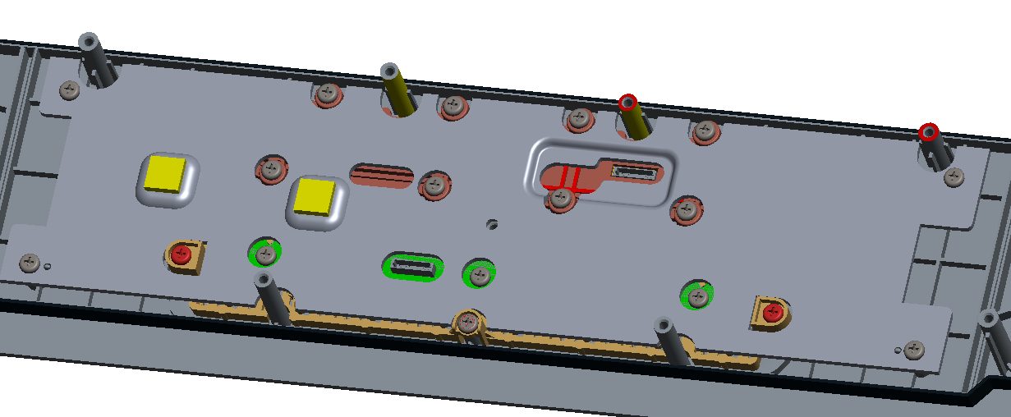
can we update the heatspreader_AMP_Top likes this? So that it is more easy to insert the cable connector.
Accordingly, the holder_mic needs to be make a cut out(in red color) to prevent interference.
Pls confirm if available?
ALT Feedback
This structure is not recommend. If apply this update, we expected side effect “Vibration and noise”
And holder_mic cut out the ribs as you marked, It will weaken the fixation strength on the bracket. As a result, it can affect the microphone ceiling.
Inkel & ALT suggest to more easy to insert cable connect, See the Next page

Slide 7
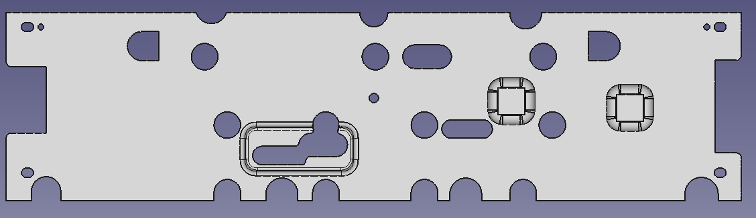
ALT
Make the hole bigger than it is now.
heatspreader_amp_top_assy_20201012.stp
ALT
Delete. Not use hole
ALT
OPEN Red square section
ALT Feedback
To ease insert the connector, open bigger connector area hole. “Red square section “

Slide 8
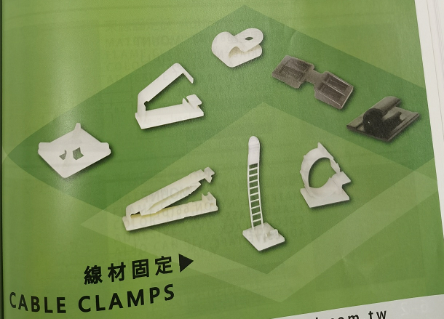
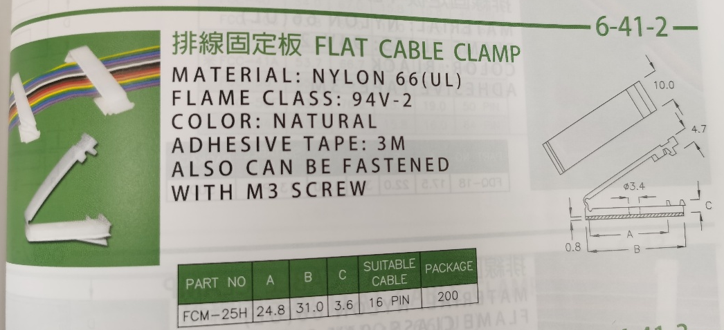
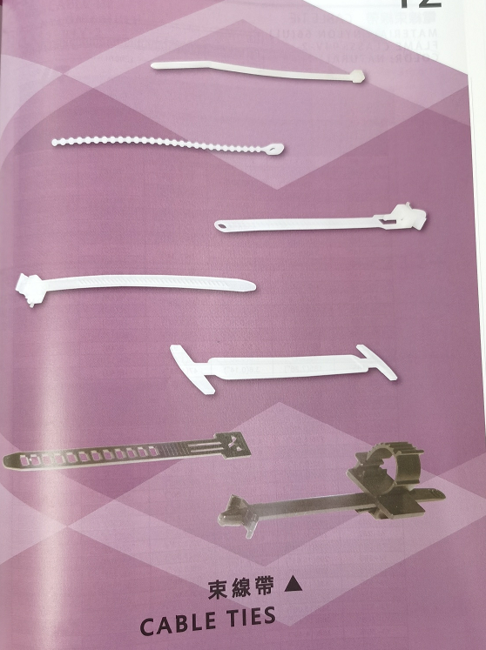
We need cable ties and clamp in next coming production. Any requirement for this from Inkel’s point of view?
Feedback from Inkel
19.oct’20 Mecha : If space allows, you can use a tie or clamp. It is also important to wrap the cable covering with foam material.
ALT Feedback
If apply this clamp, make the prevention action “Vibration and noise”

